Slide 1
Fire detection and alarm For forest fire
S.JOE MATHEW
MOHANA PRIYAN P AND KAMALESH G

Slide 2
Open cv
OpenCV (Open Source Computer Vision Library) is a library of programming functions mainly aimed at real-time computer vision.
Using Opencv to detect Fire from video or you can use real camera and also use playsound library for sound.
My project is mainly focused to use for Forest Fire.

Slide 3
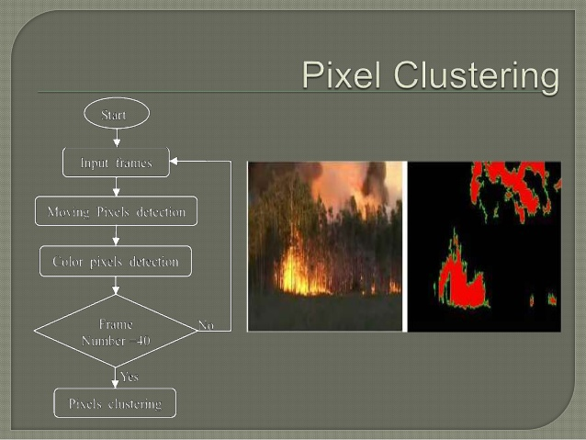

Slide 4
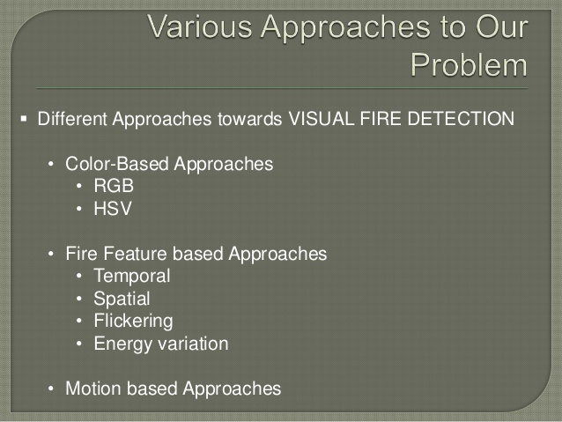

Slide 5
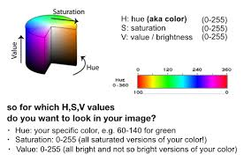
Choosing upper and lower bound

Slide 6

Bitwise operator use

Slide 7

Choosing Threshold to detect fire..

Slide 8
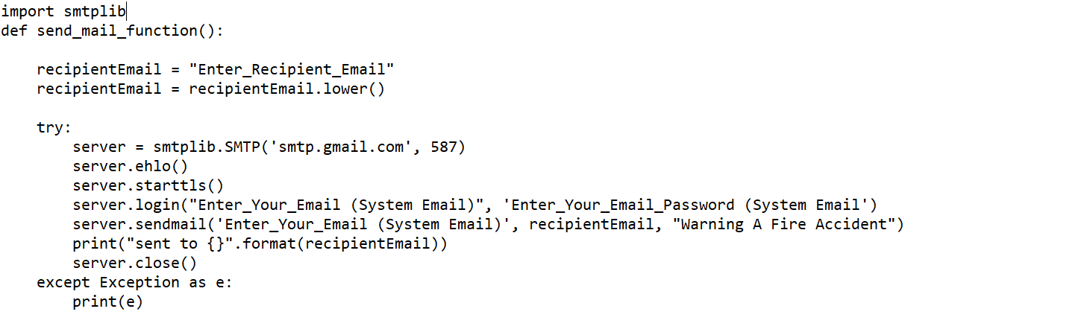

Additional: Sending email

Slide 9

Note :https://joemathew-it19.github.io/ ➔ my Blog to check it.

Slide 10


